Slide 1
FSL course

Slide 2
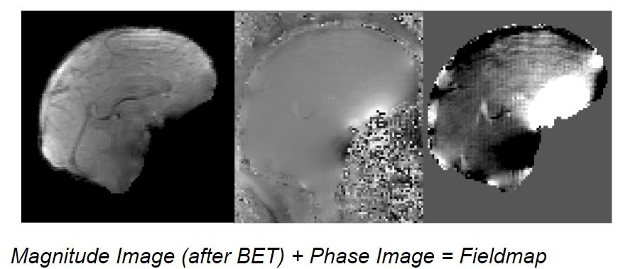
Field map

Slide 3


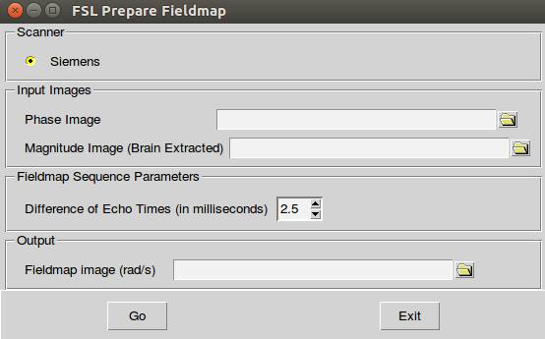
Field map(cont.)
Magnitude image + Phase image
Echo time = 2.46ms

Slide 4
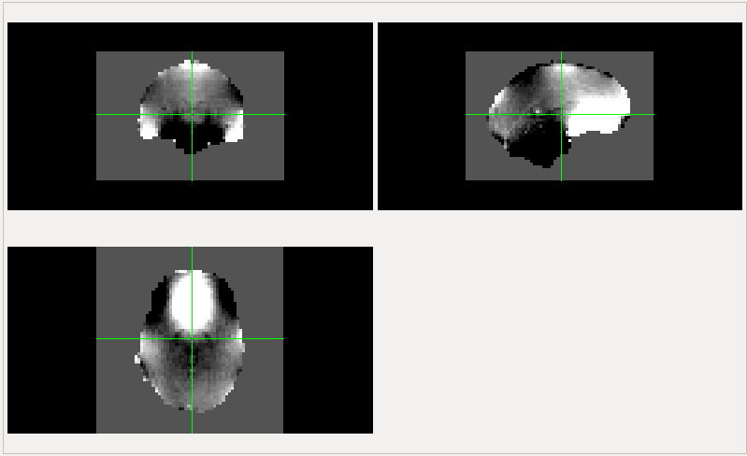
Field map(cont.)
+
0
-

Slide 5
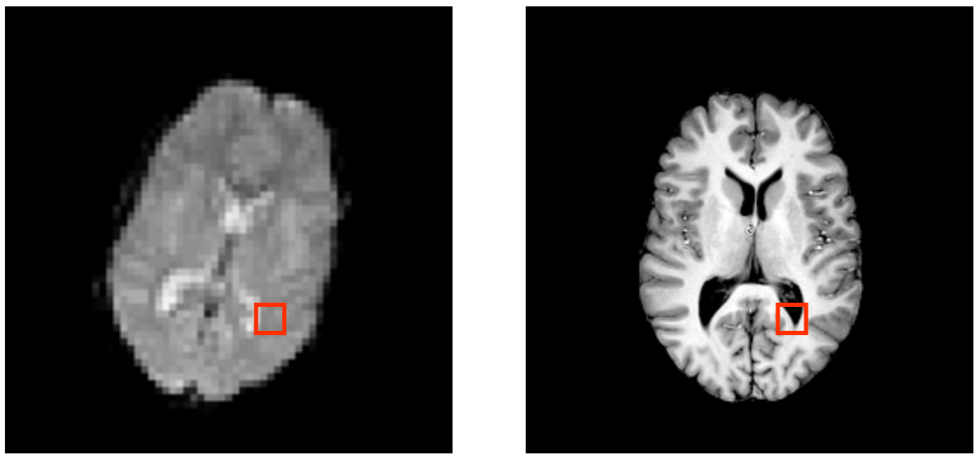
Registration

Slide 6
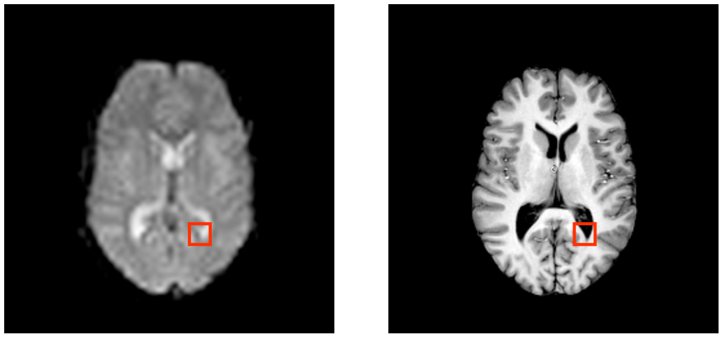
Registration(cont.)

Slide 7
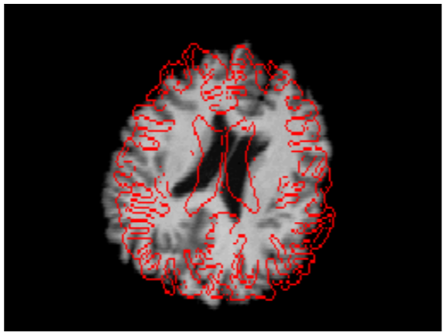
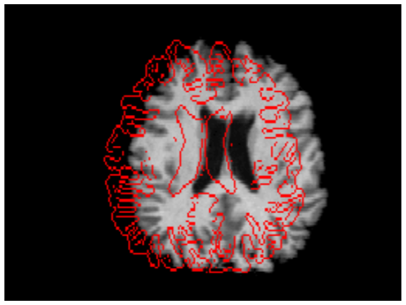
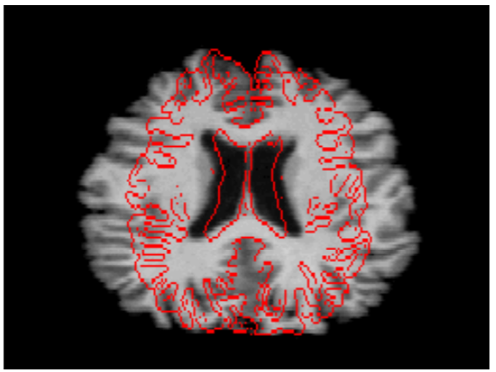
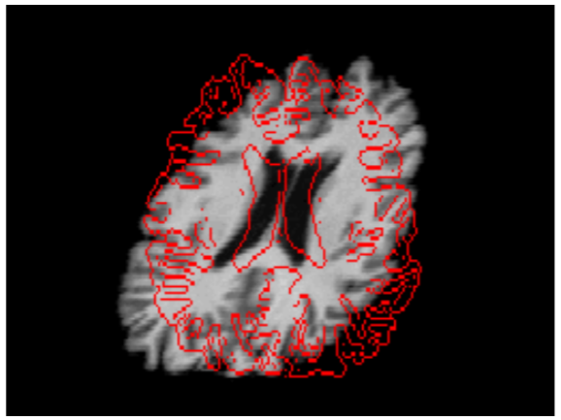
Registration(cont.)
FLIRT(6DOF)
3 Rotations
3 Translations
FNIRT(12DOF)
3 Scalings
3 Skews/Shears

Slide 8
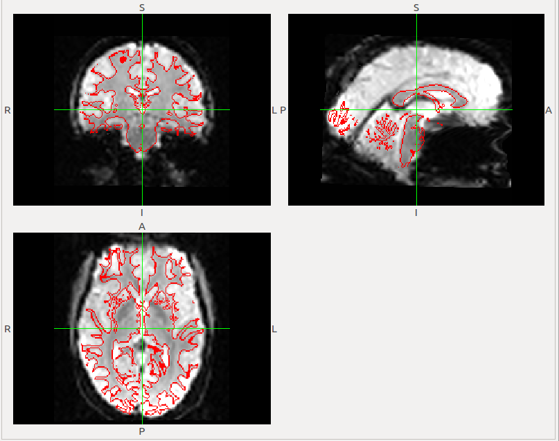
Registration(cont.)
this image shows the location of the white matter edges

Slide 9
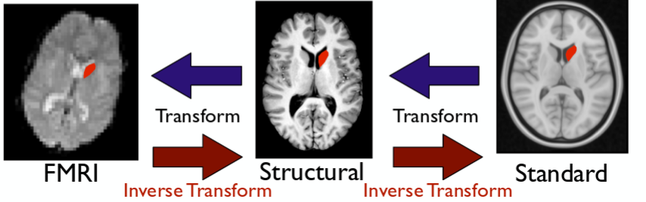
Registration(cont.)

Slide 10
Registration(cont.)
Question 1:
What differences can you see between the registrations with and without fieldmaps?

Slide 11
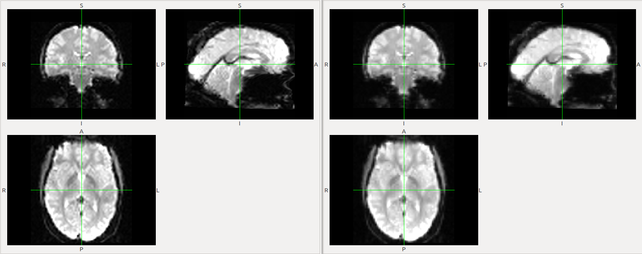
Registration(cont.)
Without Unwarping

Slide 12
Registration(cont.)
Unwarping

